Slide 1
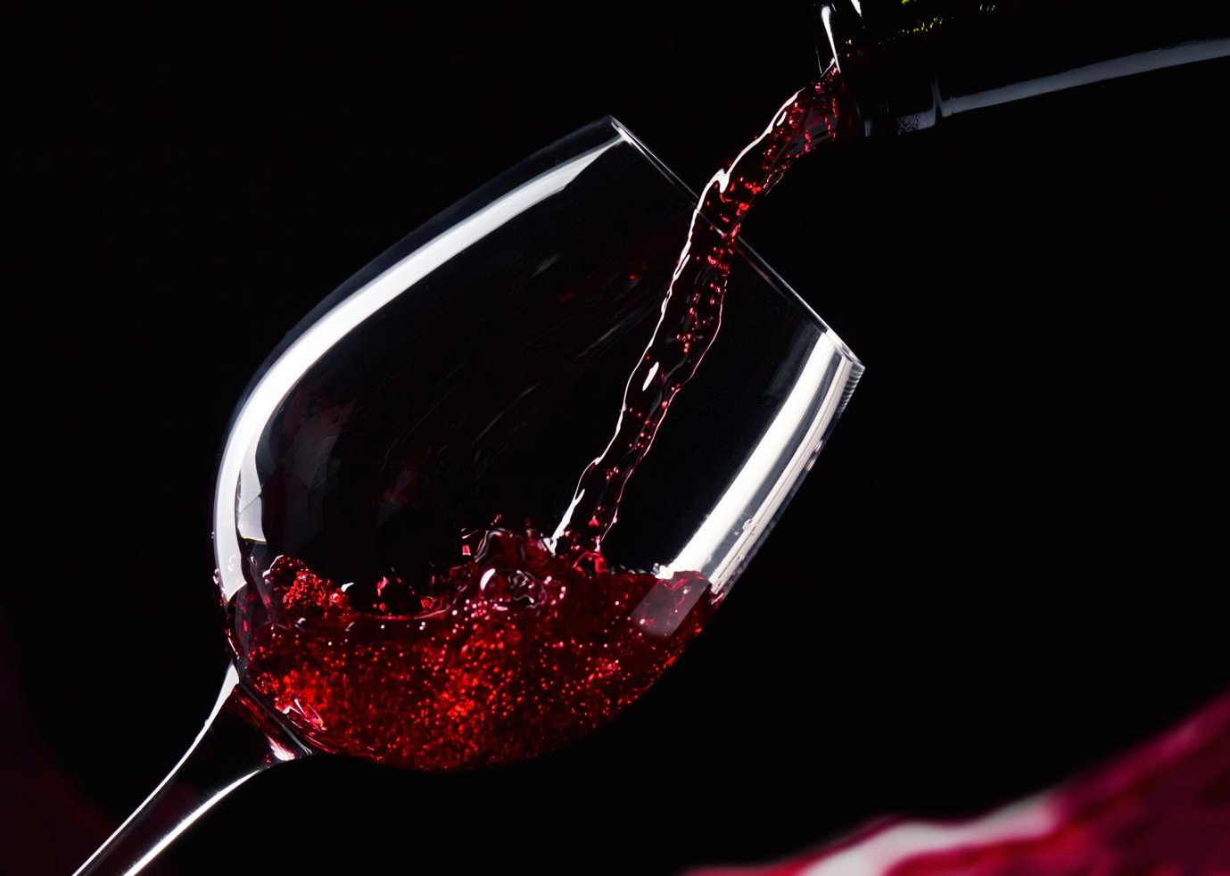
World of Wine

Slide 2
Red Wine

Slide 3
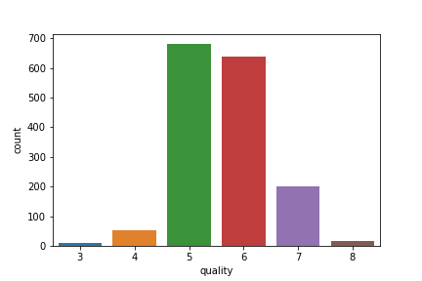

Slide 4
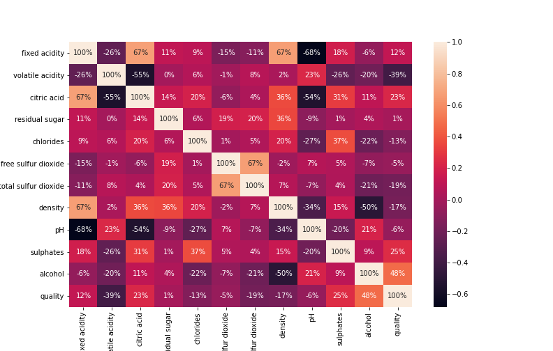

Slide 5
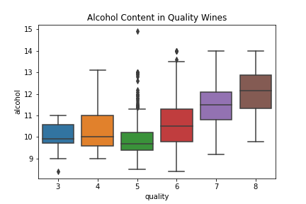

Slide 6
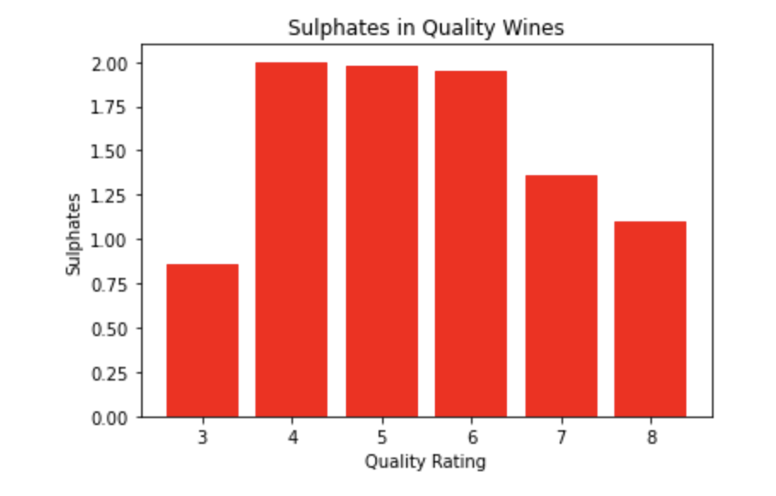

Slide 7
White Wine

Slide 8
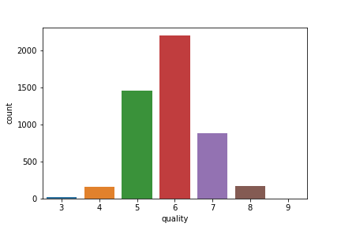

Slide 9
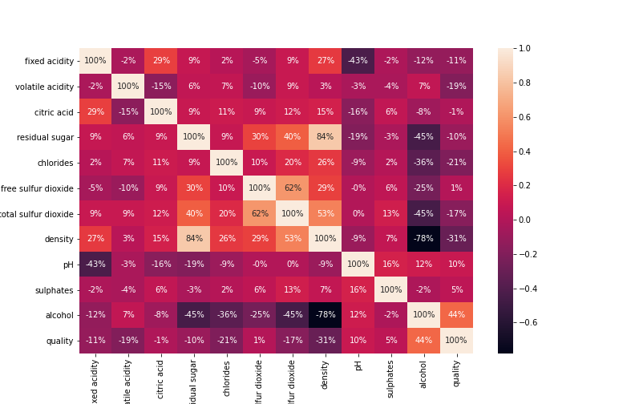

Slide 10
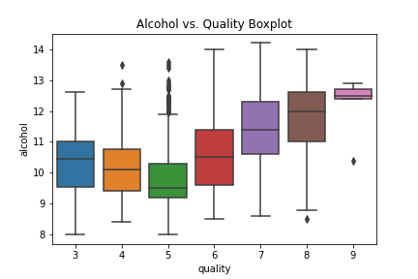

Slide 11
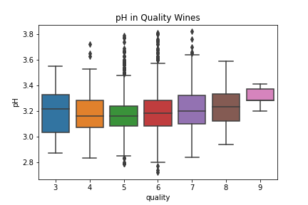

Slide 12
MACHINE LEARNING

Slide 13
HEADLINE: The Included Data Features Do Not Predict The Quality Score A Wine Will Be Given

Slide 14
3 Machine Learning Algorithms Included: 1. Multiple Regression 2. Random Forest 3. Neural Network

Slide 15
Regression Goal
Features →Target
Linear

Slide 16
Data Requirement
Feature Independence
No Correlations Nor Causations

Slide 17
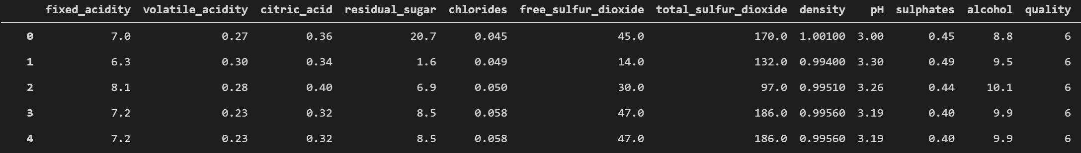
Data

Slide 18
Data

Slide 19
Data
No independence: Features All Correlated or Causal
Dependent Variable Quality is Not Described By Features

Slide 20
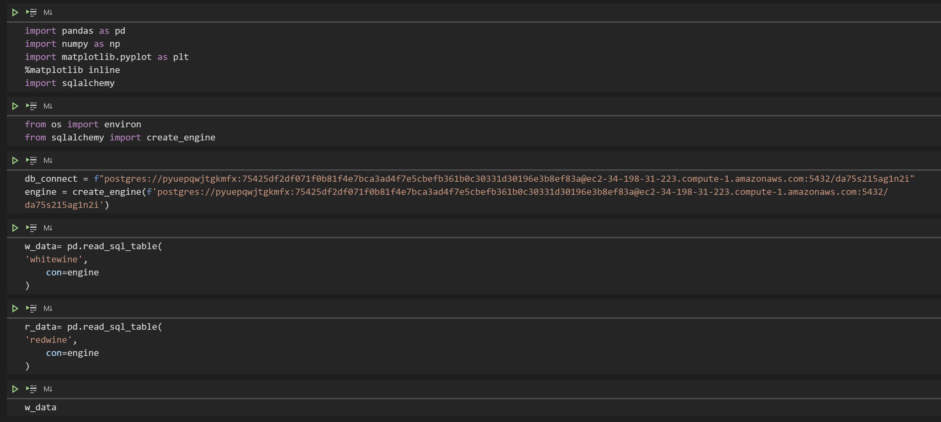
Multiple Regression
Dependencies and Data

Slide 21
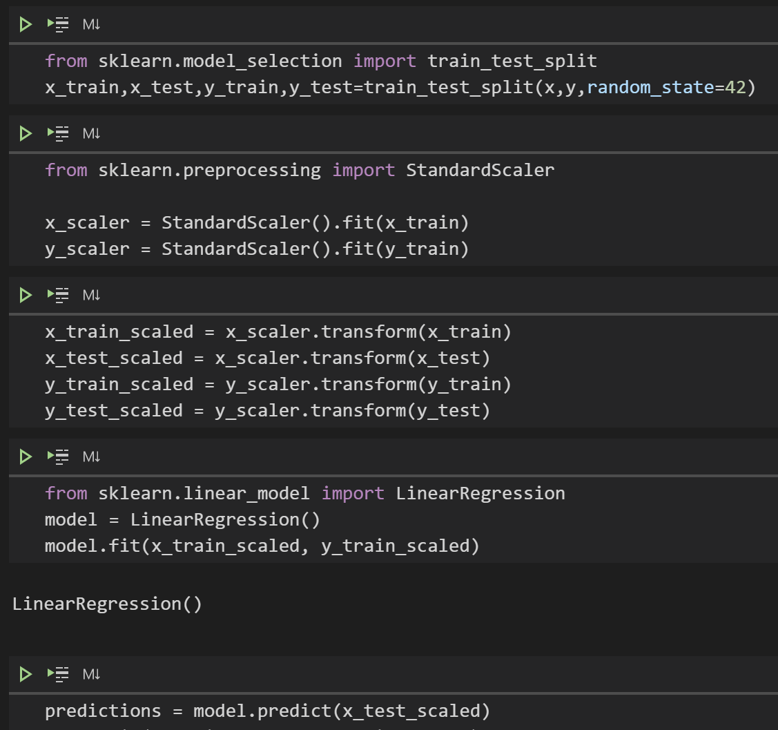
Multiple Regression

Slide 22
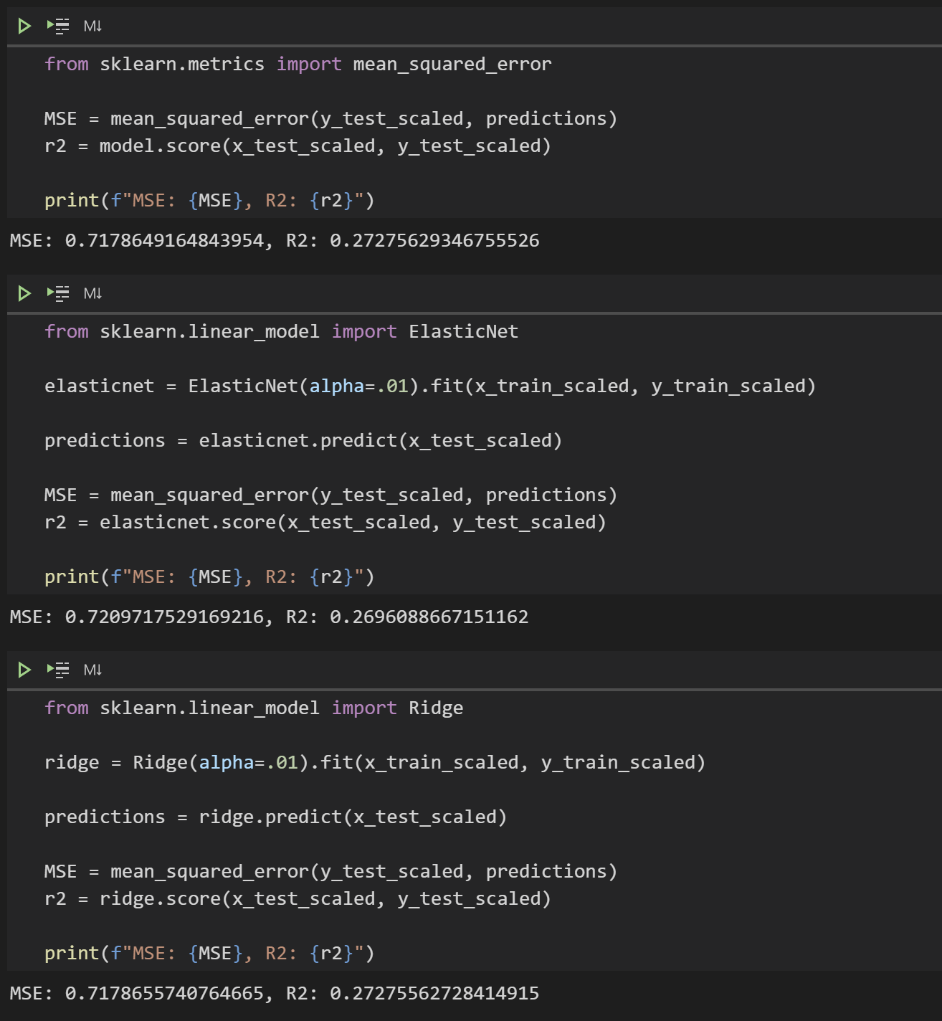
Multiple Regression

Slide 23
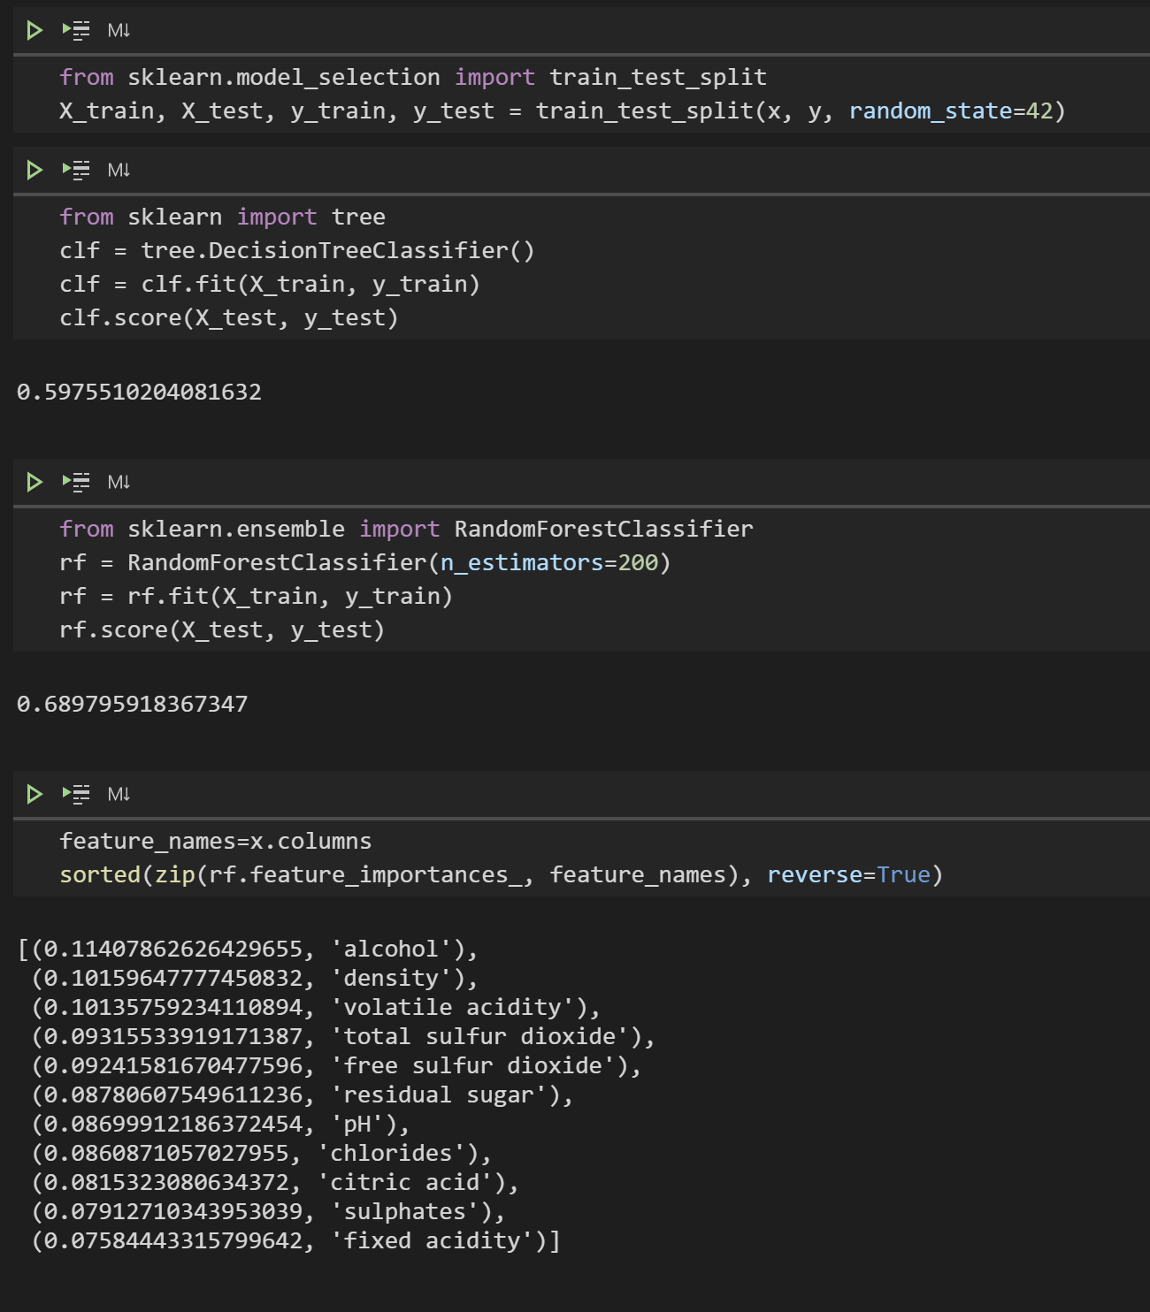
Random Forest

Slide 24
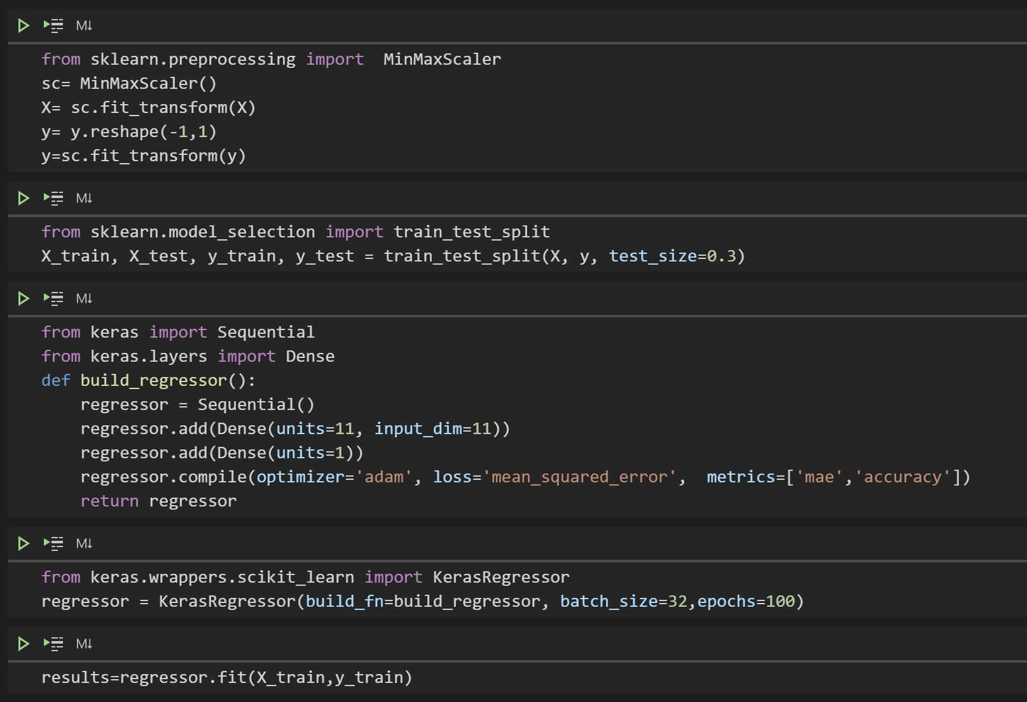
Neural Network

Slide 25
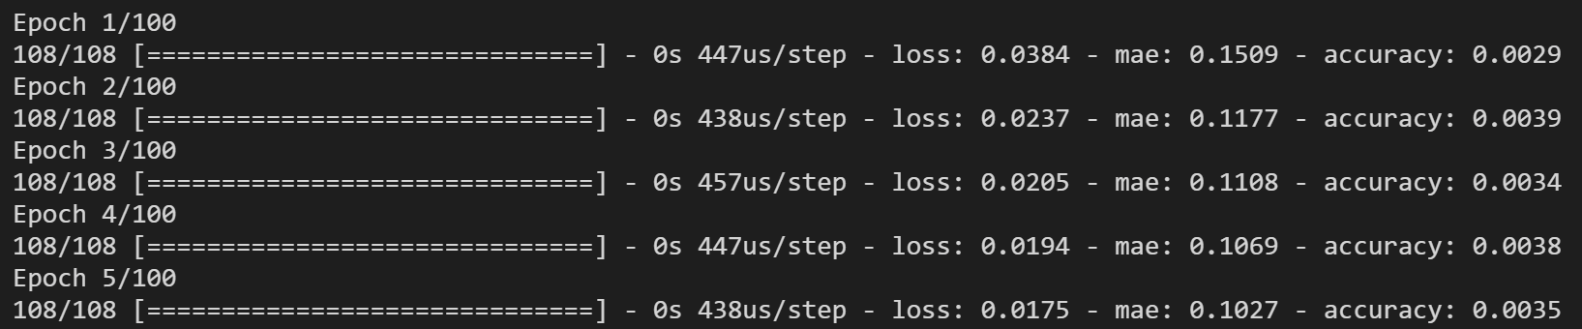
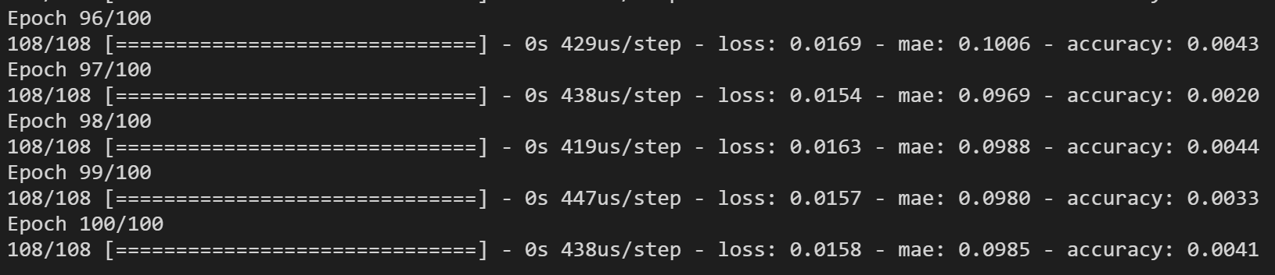
Neural Network

Slide 26
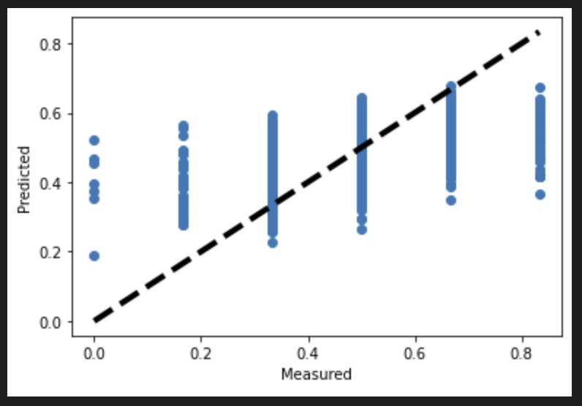
Neural Network

